Slide 1




NEXT GEN EMPLOYABILITY PROGRAM
Creating a future-ready workforce
Team Members
College Name
Student Name : AKILAN S S
Student ID : au814721104301
SRM TRP ENGINEERING COLLEGE

Slide 2

CAPSTONE PROJECT SHOWCASE
Project Title
Notes Sharing Web Application using Django Framework
Abstract | Problem Statement | Project Overview | Proposed Solution | Technology Used | Modelling & Results | Conclusion

Slide 3
Abstract
Our project focuses on developing a specialized notes sharing web application designed specifically for teachers to share educational materials with their students. The platform will offer a streamlined interface for teachers to create, organize, and share notes, presentations, study guides, and other relevant resources with their students. Students will have access to a centralized repository of materials shared by their teachers, facilitating easy retrieval and reference. Features such as annotations, highlighting, and search capabilities will enhance the learning experience, allowing students to interact with the content effectively.
Source :

Slide 4
Problem Statement
Develop a platform that enables teachers to efficiently share educational materials, such as lecture notes, assignments, and study guides, with their students. The platform should facilitate easy uploading, organization, and distribution of content, while also providing features like notifications, collaboration tools, and secure access controls to ensure a seamless and effective learning experience for both teachers and students."
Source :

Slide 5
Project Overview
Introduction:* - Briefly introduce the purpose of the application, which is to facilitate the sharing of educational materials from teachers to students.
Key Features:* - *User Authentication:* Implement secure login/signup functionality for both teachers and students. - *File Upload:* Allow teachers to upload various types of files such as PDFs, documents, images, and videos. - *Content Organization:* Provide tools for teachers to organize their content into courses, subjects, or categories. - *Notifications:* Notify students about new uploads, announcements, or upcoming assignments. - *Collaboration Tools:* Include features for students to ask questions, participate in discussions, and collaborate with peers. - *Access Controls:* Ensure that only authorized users can access and download specific content. - *Search Functionality:* Enable users to search for specific notes or topics within the application. - *Feedback Mechanism:* Allow students to provide feedback on the quality and usefulness of the shared materials.
Technology Stack:* - Specify the technologies and frameworks you'll use for frontend development (e.g., React.js), backend development (e.g., Node.js, Django), and database management (e.g., MongoDB, PostgreSQL).
Source :

Slide 6
Proposed Solution
.
Development Process:* - Describe your development methodology (e.g., Agile, Scrum) and outline the different phases of development, including planning, design, implementation, testing, and deployment.
Monetization Strategy (if applicable):* - If you plan to monetize the application, describe your pricing model (e.g., subscription-based, freemium) and any additional features or services for premium users.
Future Enhancements:* - Discuss potential future enhancements such as mobile app development, integration with learning management systems (LMS), or advanced analytics for user engagement.7. *Conclusion:* - Summarize the key points of your project overview and emphasize the benefits it will bring to teachers and students in terms of efficient content sharing and enhanced learning experiences.
Source :

Slide 7


Technology Used
Front-end
Back-end
Source :

Slide 8
Modelling & Results
Database Modeling
User Interface Modeling
Backend Development
Frontend Development
Testing
Deployment
Source :

Slide 9
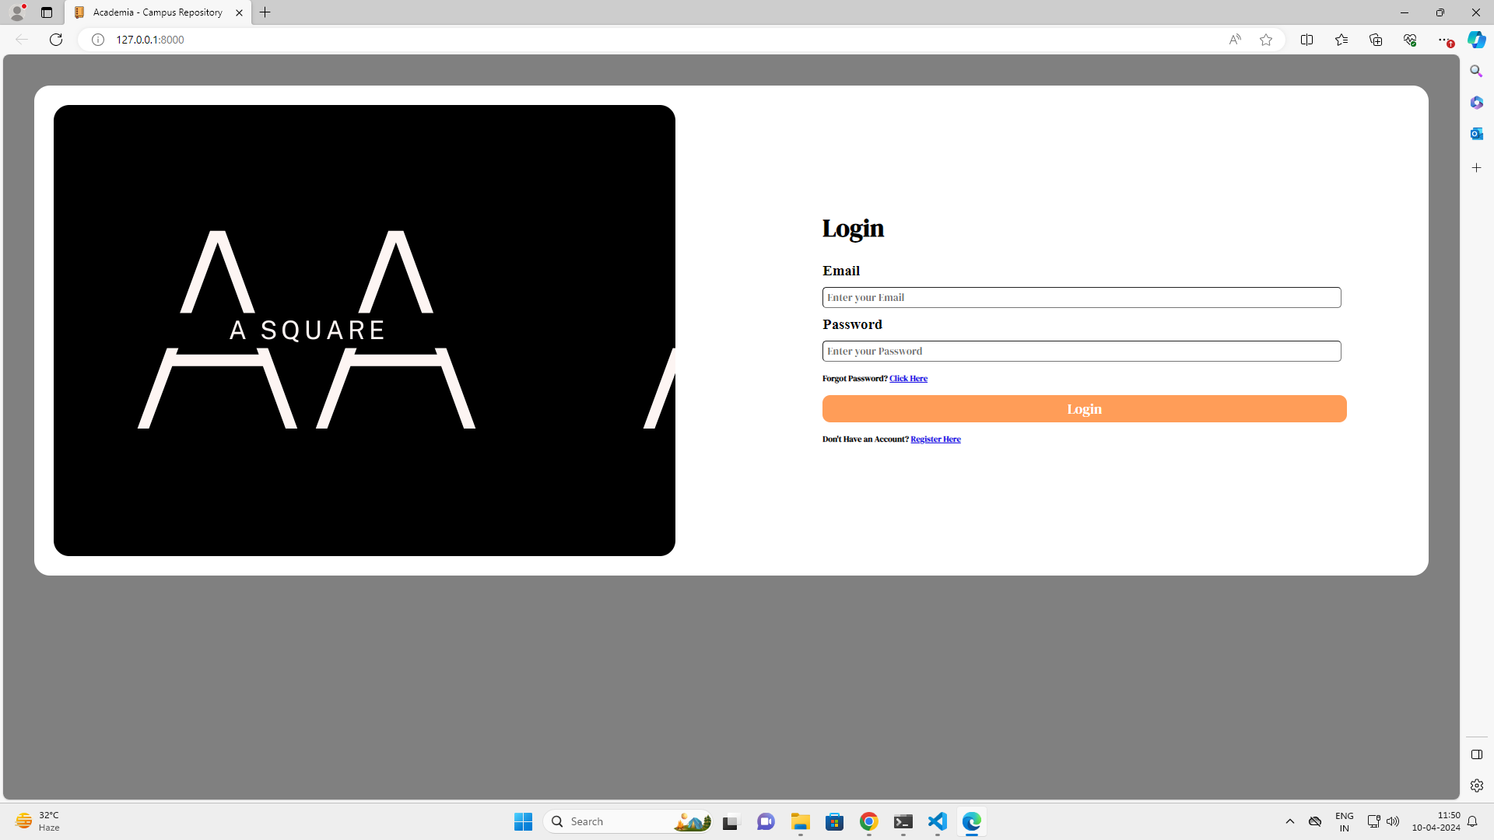
Login Page

Slide 10
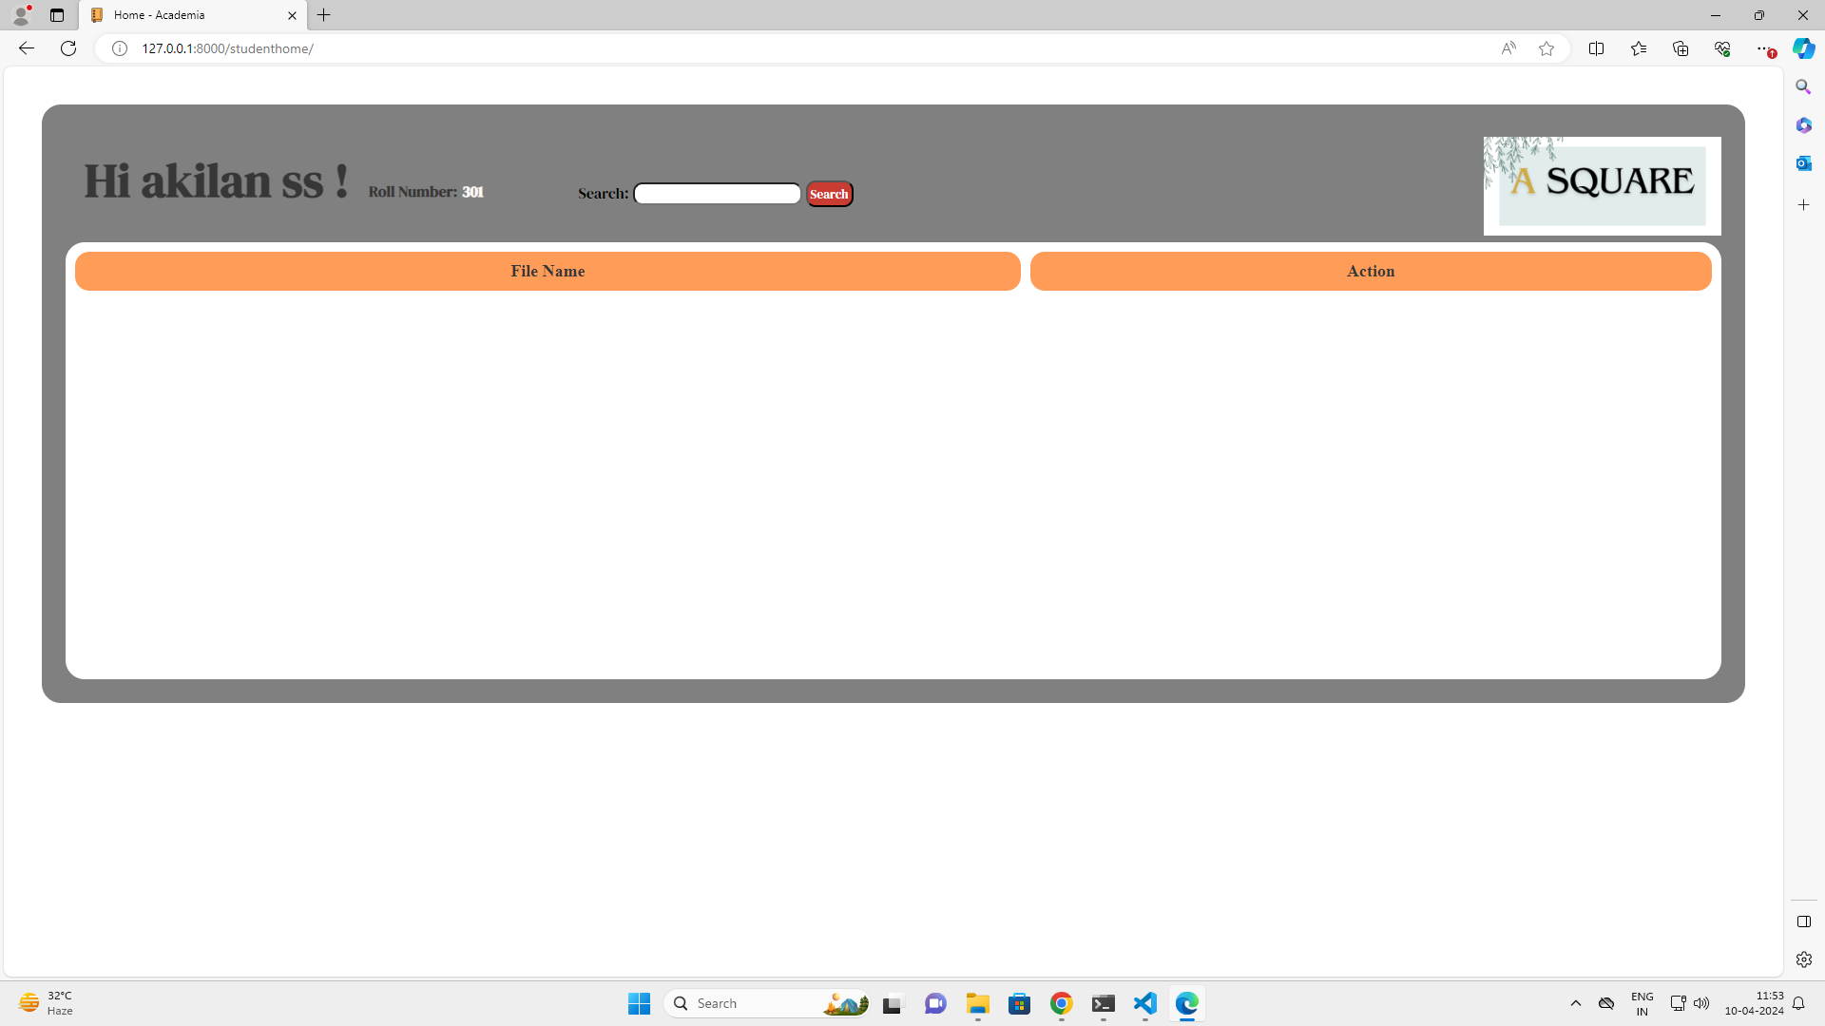
Home Page

Slide 11
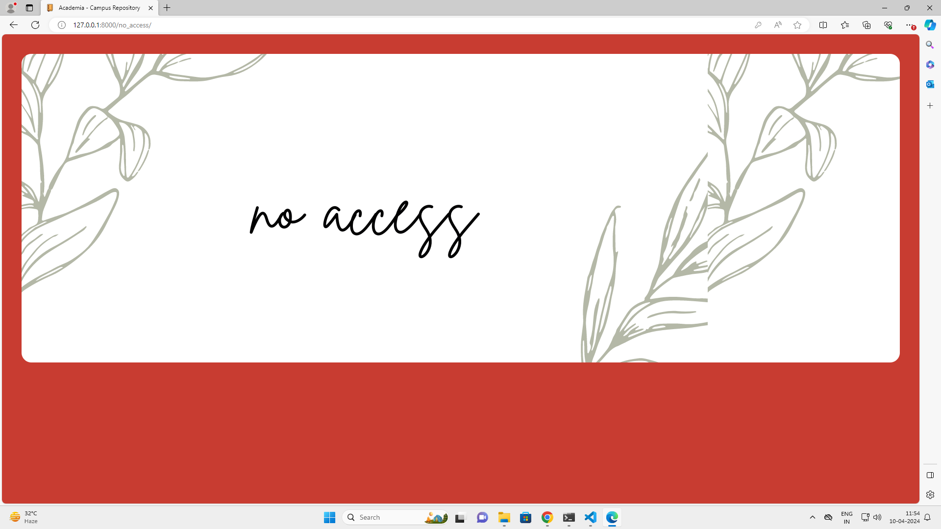
No access Page

Slide 12
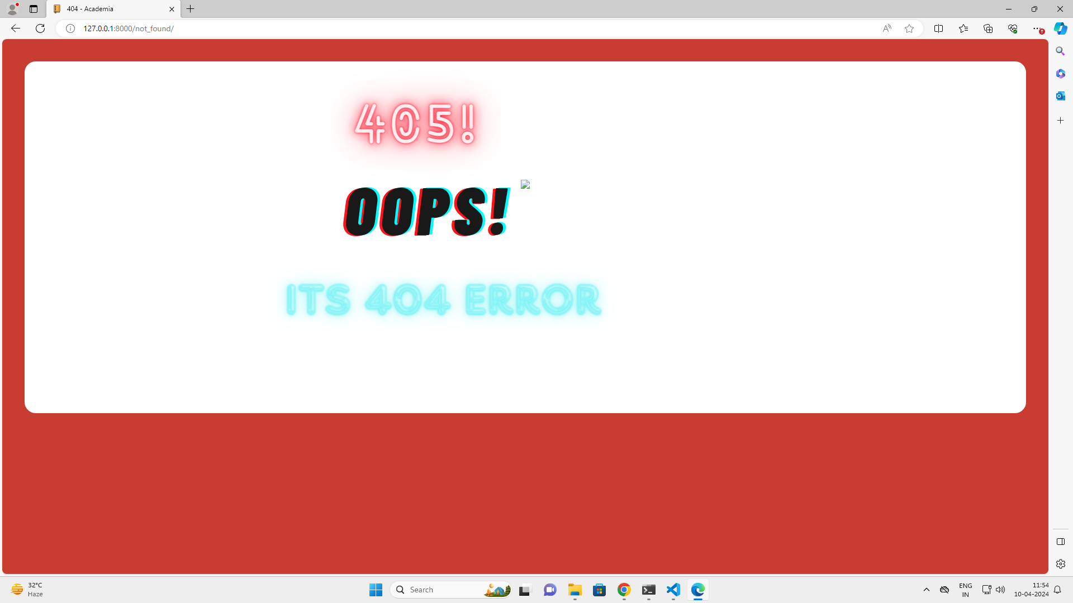
404 error Page

Slide 13
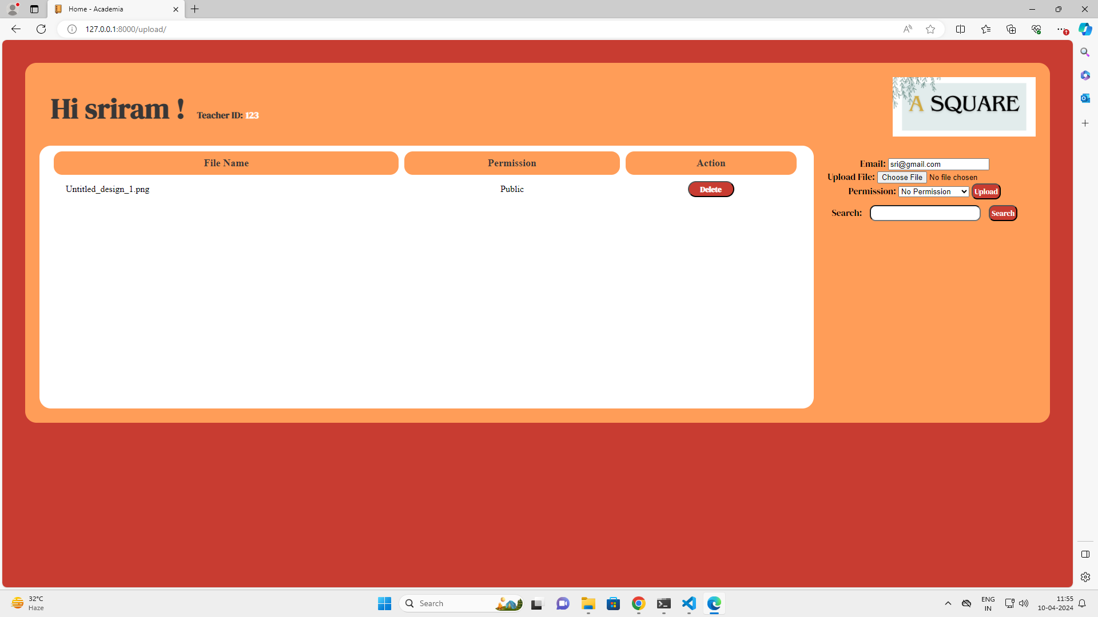
Teacher home Page

Slide 14
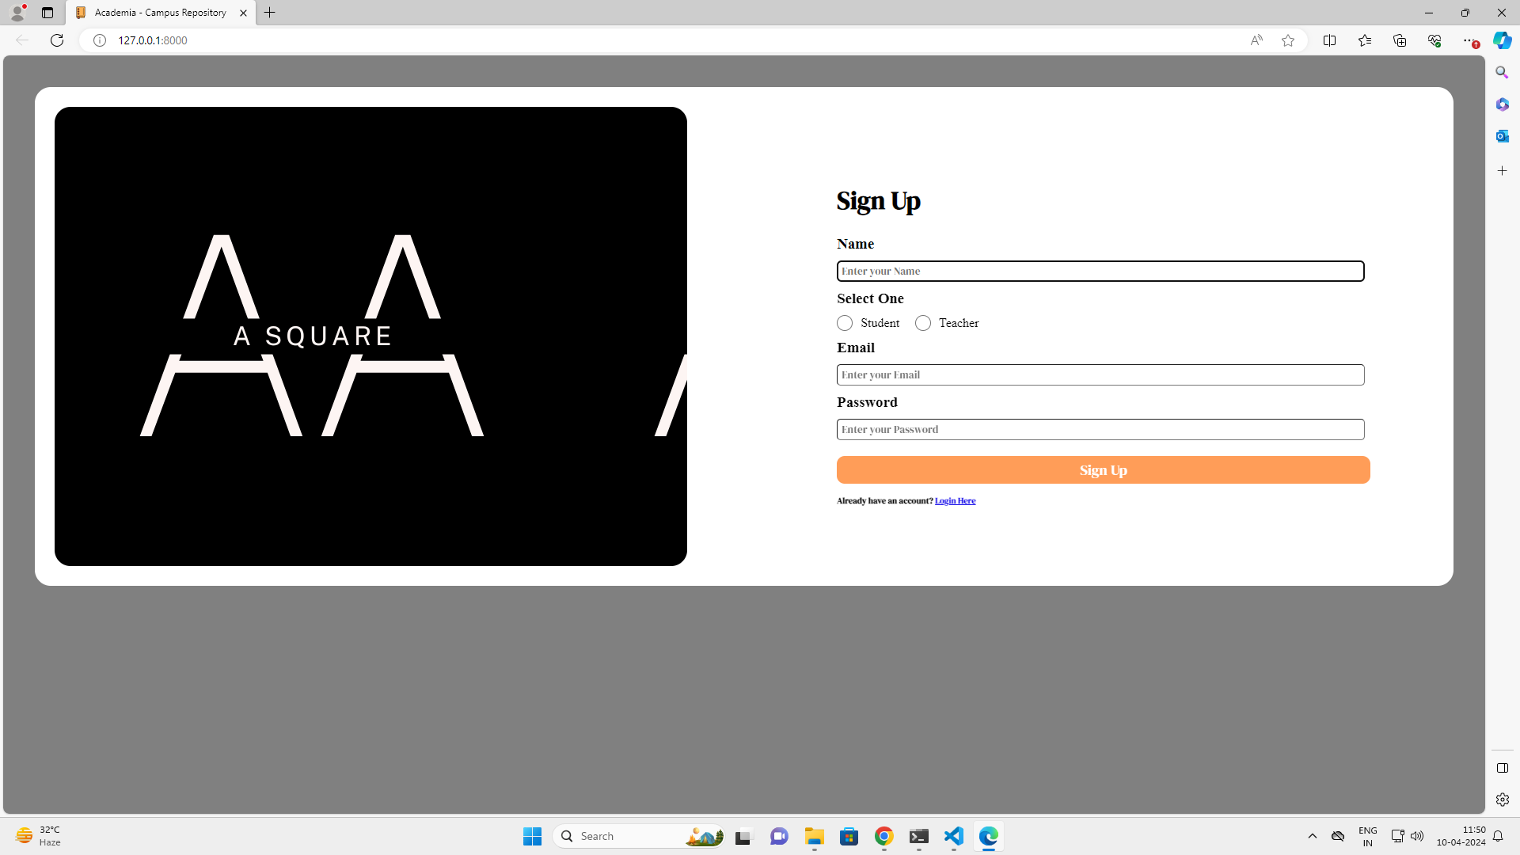
Sign up Page

Slide 15
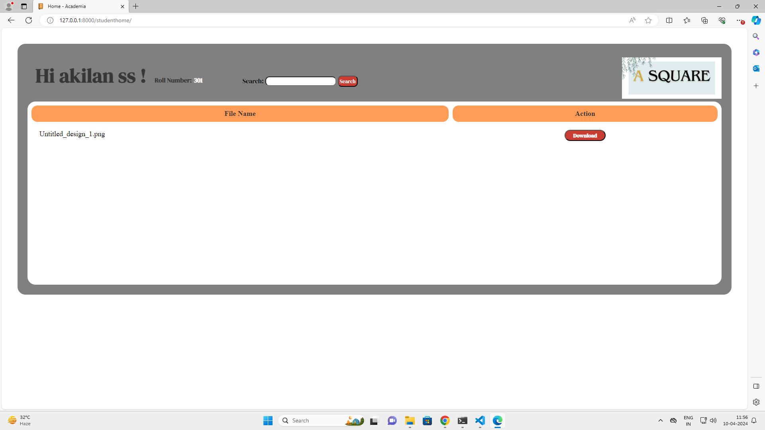
File uploaded Page

Slide 16
Future Enhancements:
Develop a mobile app for iOS and Android platforms.
Integrate with popular Learning Management Systems (LMS) like Moodle or Canvas.
Implement AI-driven content recommendations for personalized learning.
Enhance collaboration with real-time editing and virtual whiteboards.
Introduce gamification elements for increased student engagement.
Create an advanced analytics dashboard for teachers.
Improve accessibility with screen reader compatibility and keyboard navigation.
Integrate virtual classroom tools such as live video lectures and breakout rooms.
Establish a content marketplace for teachers to share and sell premium materials.
Partner with external educational resources for expanded content options.

Slide 17
Conclusion
The notes sharing web application bridges the gap between teachers and students, offering a seamless platform for efficient content distribution and collaboration. With advanced features like AI-driven recommendations, real-time collaboration tools, and gamification elements, it enhances engagement and personalized learning experiences. Integration with LMS platforms and accessibility enhancements further enrich the platform's functionality. Overall, it revolutionizes education by promoting interactive learning and facilitating a more connected classroom environment.
Source :

Slide 18
Thank You!
Notes:
Thank You !!

